Slide 1
INTRODUCTION TO BIGDATA WITH HADOOP BY anjana v

Slide 2

BIGDATA

Slide 3
BIGDATA
Big data means really a big data, it is a collection of large datasets that cannot be processed using traditional computing techniques.
Its generates value from the storage and processing of very large quantities of digital information that cannot be analyzed with traditional computing techniques.
There are three dimensions to big data known as Volume, Variety and Velocity

Slide 4
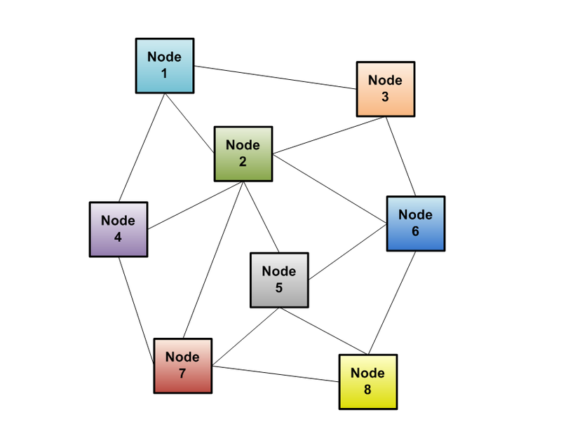
SOLUTION – DISTRIBUTED SYSTEM

Slide 5
DISTRIBUTED SYSTEM - APPROACH
A new approach of the distributed system is called as Hadoop
HADOOP
Although the analysis can be done using the traditional RDBMS , we opt for Hadoop since data to be evaluated for insights is very large and by using RDBMS the total time of analysis would be 10 times more than in Hadoop.
Thus the involvement of large set of data urges the user to choose Hadoop framework for analysis rather than the traditional RDBMS technologies

Slide 6

HADOOP
Apache Hadoop is an open-source software framework for storage and large-scale processing of data-sets on clusters of commodity hardware.
Some of the characteristics:
Open source
Distributed processing
Distributed storage
Scalable
Reliable
Fault-tolerant
Economical
Flexible

Slide 7
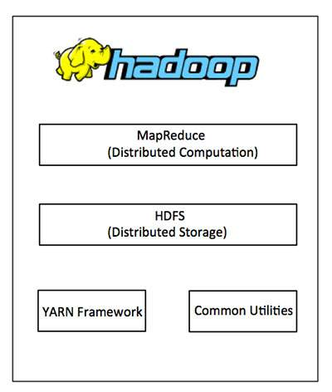
ARCHITECTURE OH HADOOP

Slide 8
HADOOP COMPONENTS
HDFS
MAPREDUCE
HIVE
PIG
SQOOP
FLUME
HBASE
OOZIE
ZOOKEEPER
YARN
SPARK
CASSENDRA

Slide 9
HDFS
A distributed file system that provides high-throughput access to application data.
It is suitable for the distributed storage and processing.
Hadoop provides a command interface to interact with HDFS.
The built-in servers of namenode and datanode help users to easily check the status of cluster.
Streaming access to file system data.
HDFS provides file permissions and authentication

Slide 10
Data Storage using HDFS
The data set is approximately 500MB in size
The block size is set to 27MB in hdfs-site.xml
So the number of blocks is 500/27 ≈ 18
The number of input splits is also 18 because the record size is not very big. Incase any record is broken down it will be taken up by the first block to complete the split.
The H1B Visa data set is cleaned and stored in HDFS

Slide 11
NODES
NameNode:
Master of the system
Maintains and manages the blocks which are present on the DataNodes
DataNodes:
Slaves which are deployed on each machine and provide the actual storage
Responsible for serving read and write requests for the clients
Jobtracker:
takes care of all the job scheduling and assign tasks to Task Trackers.
TaskTracker:
a node in the cluster that accepts tasks - Map, Reduce and Shuffle operations - from a jobtracker

Slide 12
NameNode:
Stores metadata for the files, like the directory structure of a typical FS.
The server holding the NameNode instance is quite crucial, as there is only one.
Transaction log for file deletes/adds, etc. Does not use transactions for whole blocks or file-streams, only metadata.
Handles creation of more replica blocks when necessary after a DataNode failure

Slide 13
DataNode:
Stores the actual data in HDFS
Can run on any underlying filesystem (ext3/4, NTFS, etc)
Notifies NameNode of what blocks it has
NameNode replicates blocks 2x in local rack, 1x elsewhere

Slide 14
MAPREDUCE
MapReduce is a processing technique and a program model for distributed computing based on Java.
A MapReduce program is composed of a Map() procedure that performs filtering and sorting (such as sorting students by first name into queues, one queue for each name) and a Reduce() method that performs a summary operation (such as counting the number of students in each queue, yielding name frequencies).
Map takes a set of data and converts it into another set of data, where individual elements are broken down into tuples (key/value pairs).
Secondly, reduce task, which takes the output from a map as an input and combines those data tuples into a smaller set of tuples

Slide 15
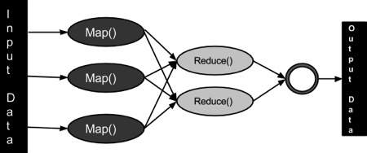
MapReduce ARCHITECTURE

Slide 16
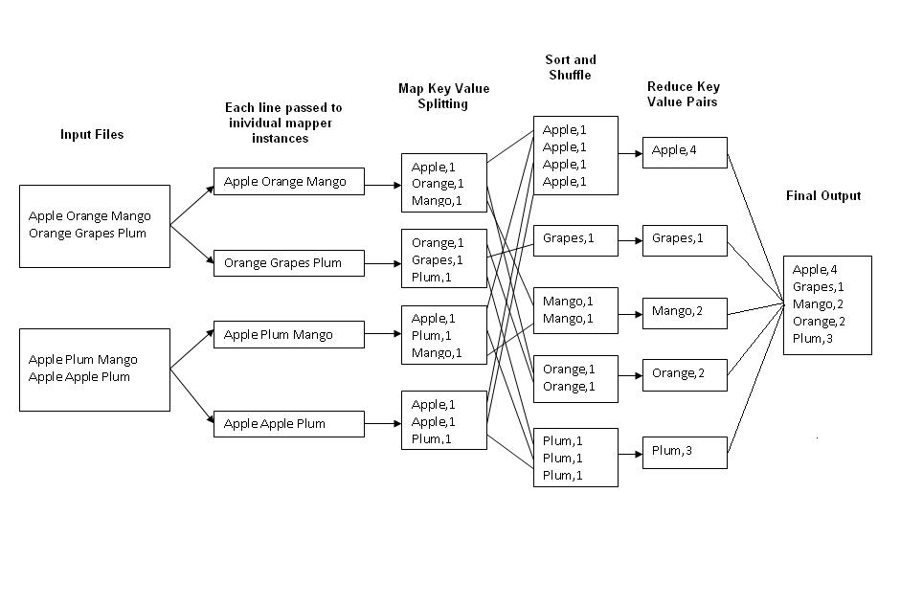
EXAMPLE : WORD COUNT

Slide 17
DISADVANTAGES OF MR
Failures are norm in commodity hardware
Worker failure
Detect failure via periodic heartbeats
Re-execute in-progress map/reduce tasks
Master failure
Single point of failure; Resume from Execution Log
Robust
Google’s experience: lost 1600 of 1800 machines once!, but finished fine

Slide 18
HIVE
Hive is a data warehouse infrastructure tool to process structured data in Hadoop.
Apache Hive is a data warehouse software project built on top of Apache Hadoop for providing data summarization, query, and analysis.
.

Slide 19
FEATURES OF HIVE
It stores schema in a database and processed data into HDFS.
It is designed for OLAP.
It provides SQL type language for querying called HiveQL or HQL.
It is familiar, fast, scalable, and extensible.

Slide 20
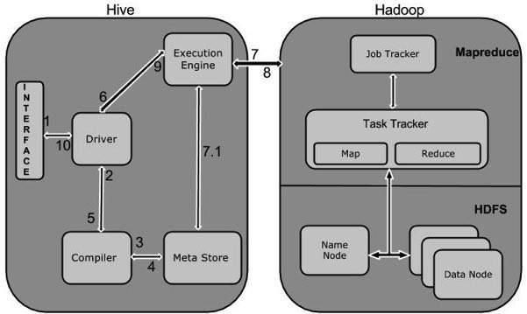
HIVE WORKFLOW

Slide 21
PIG
Apache Pig is an abstraction over Map Reduce. It is a tool/platform which is used to analyze larger sets of data representing them as data flows. Pig is generally used with Hadoop; we can perform all the data manipulation operations in Hadoop using Pig.
To write data analysis programs, Pig provides a high-level language known as Pig Latin.

Slide 22
FEATURES OF PIG
Handles all kinds of data
UDF’s : User-defined Functionsin
Extensibility
Optimization opportunities
Ease of programming
Rich set of operators

Slide 23
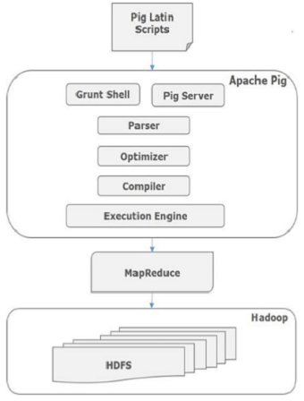
PIG ARCHITECTURE

Slide 24
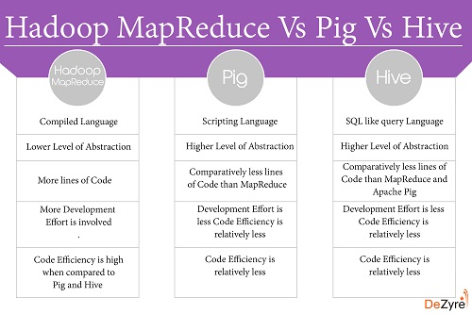
DIFFERENCE BETWEEN MR, PIG AND HIVE

Slide 25
SQOOP
Sqoop is a tool designed to transfer data between Hadoop and relational database servers. It is used to import data from relational databases such as MySQL, Oracle to Hadoop HDFS, and export from Hadoop file system to relational databases.
In the project we use Sqoop to export data from the Mapper output of Question 10 stored in HDFS into MySQL table.

Slide 26
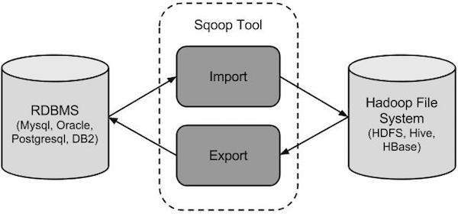
SQOOP ARCHITECTURE

Slide 27
CONCLUSION
The project on H1B Visa application dataset was given to analyse.
H1B Visa application dataset has been loaded using Hadoop framework.
Data has been processed to meaningful pieces of information using MapReduce , Hive, Pig.

